Slide 1
Data@ANZ Program Insights
ANZ synthesized transaction dataset
Total no. of data: 12044 rows
LOCATION INSIGHTS
Melbourne |  | 255
Sydney |  | 235
Southport |  | 82
N/A |  | 4326
There were a total of 1608 locations in Australia from where the transactions took place
4326 locations data were missing
Highest number of transactions were made from Melbourne (255) followed by Sydney(235) and Southport(82)

Slide 2
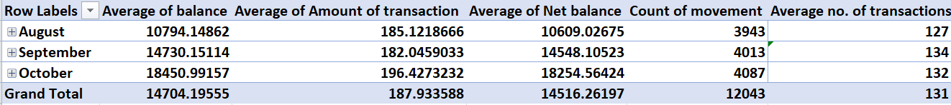
Total Average Balance: 14704.20 AUD
Highest Avg Balance: 18451 AUD – October
2. Total Average Amount of transaction: 187.93 AUD
Highest Avg Balance: 196.42– October
3. Total Average Net Balance: 14516.26 AUD
Highest Avg Net Balance: 18254.56 AUD – October
4. Highest No. of transactions: 4087 (October)
Highest Average No.of transactions: 134(September)
No of debit movements(11160) were higher than no. of credit movements(883).
Males (6285) made most of the transactions as compared to females(5758).

Slide 3
Highest No. of transactions (2149) made by males was in October’18
Highest No. of transactions (1938) made by females was in October’18
Highest transaction volume was on 29th September(174) and lowest was on 31st October(89)

